Slide 1






PANTHER SHUTTLE APP
https://yanarex.github.io/shuttle-app-website/
Members: Joseph Hilte, Tony Arrington, Jonathan Suo, and Chase Monigle

Slide 2







Driver Side Tracking
Main Objectives
Enabled Map on Drivers Side.
Implement Driver Side to see # of Students at stop.
Viewable Estimated # of Students at a stop.
Connect Driver Side & Student Side for Notifications.
Working Notifications between Driver and Student.
Connect Driver Side & Student Side for Tracking.
Working Tracking between Driver and Student,
Conduct evaluation and analyze results
Testing and Evaluation.
Create poster for Senior Design Showcase
Make our poster within constraints of the requirements.

Slide 3

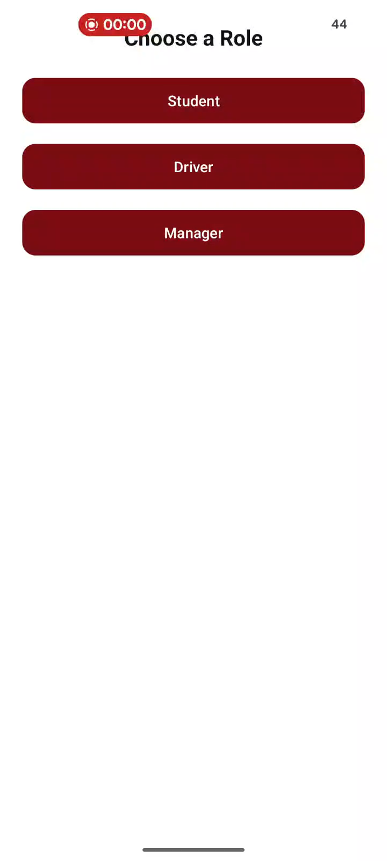



Driver Side Map

Slide 4


Working Notifications

Slide 5
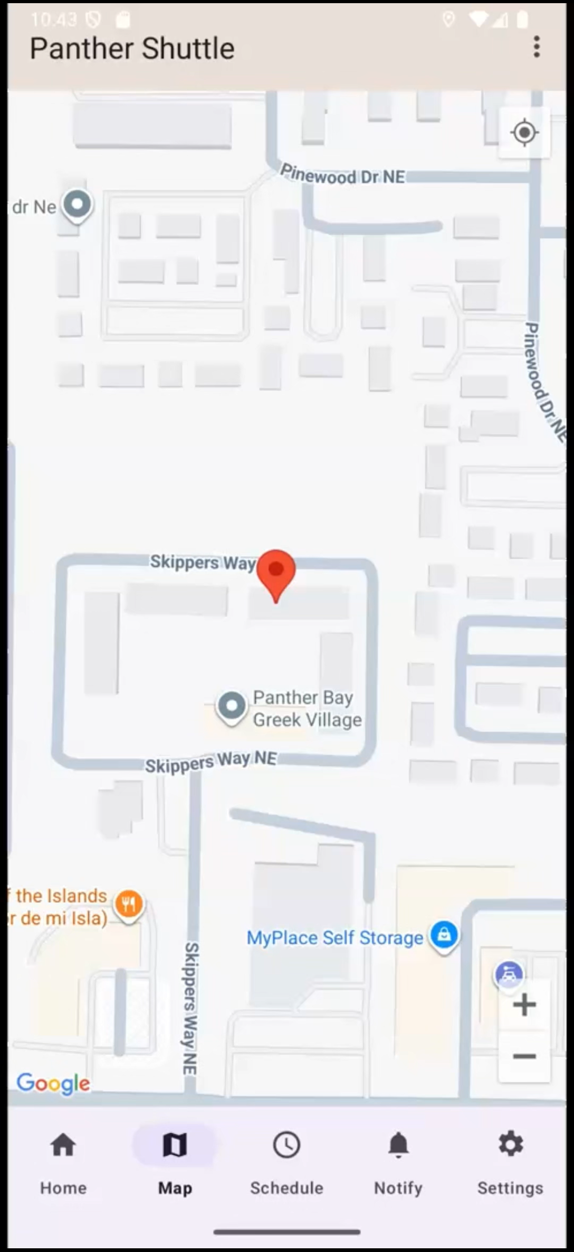

Working Tracking

Slide 6


# of Estimated Students

Slide 7
Testing + Results
Testing (Emulator/Phone):
Map
Tracking
UI
Notifications
Results:
Map: 100%
Tracking: 100%
UI: 100%
Notifications: 90%, One Bug where it wouldn’t display between Emulator/Phone.

Slide 8
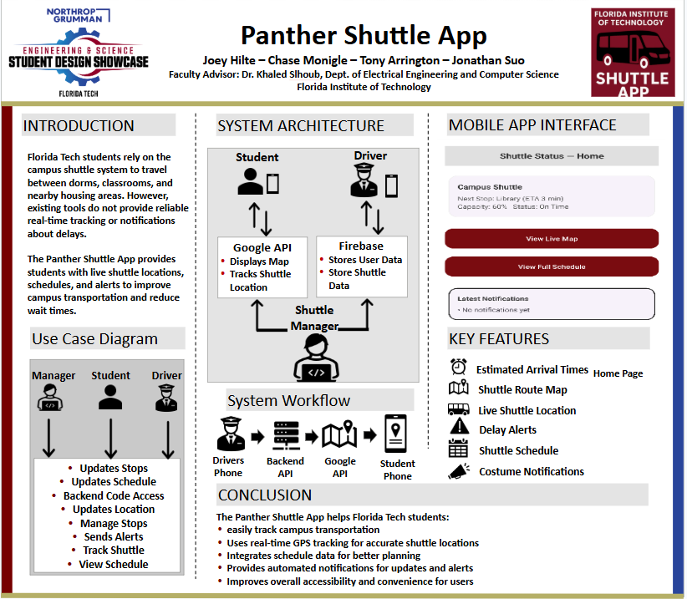
Showcase Poster

Slide 9
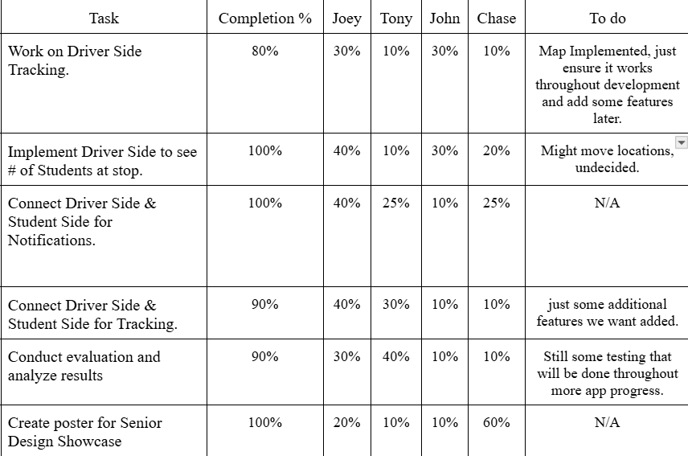


Milestone 5 Progress

Slide 10
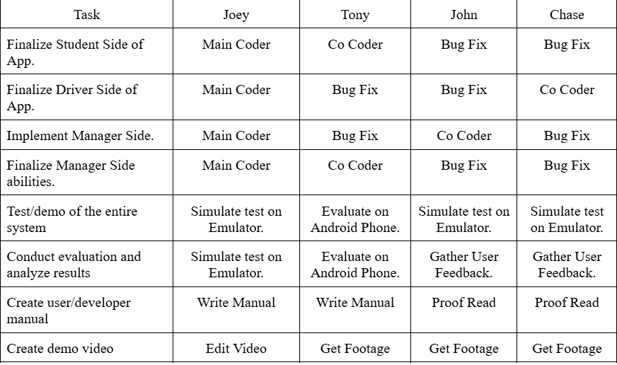
Milestone 6 Plan

Slide 11






QUESTIONS?
Visit our website
https://yanarex.github.io/shuttle-app-website/

